Slide 1
International Economic Relations ECON 308
Specific Factors and Income Distribution
(Chapter 4 Part 2)
Instructor: Muhebullah Karimzada
Notes:
If this PowerPoint presentation contains mathematical equations, you may need to check that your computer has the following installed:
1) MathType Plugin
2) Math Player (free versions available)
3) NVDA Reader (free versions available)

Slide 2
International Trade in the Specific Factors Model (1 of 3)
Trade and Relative Prices
The relative price of cloth prior to trade is determined by the intersection of the economy’s relative supply of cloth and its relative demand.
Free trade relative price of cloth is determined by the intersection of world relative supply of cloth and world relative demand.
Opening up to trade increases the relative price of cloth in an economy whose relative supply of cloth is larger than for the world as a whole.

Slide 3
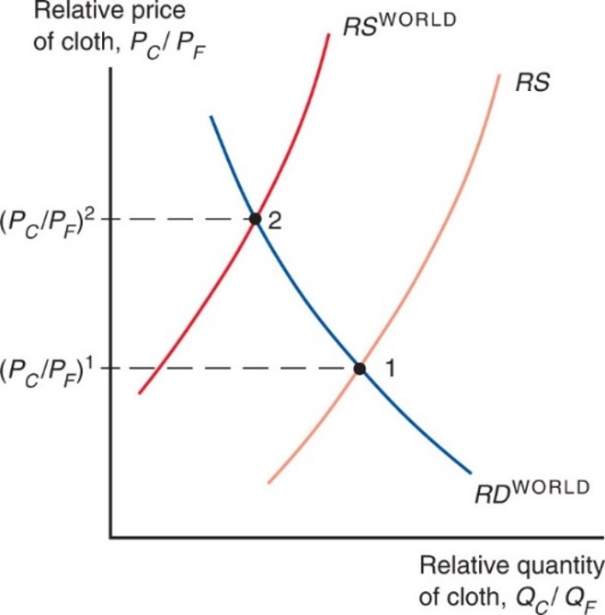
Figure 4.10 Trade and Relative Prices
The figure shows the relative supply curve for the specific factors economy along with the world relative supply curve. The differences between the two relative supply curves can be due to either technology or resource differences across countries. There are no differences in relative demand across countries. Opening up to trade induces an
increase in the relative price from
Notes:
2 R S curves, R S and R S super world, rise with increasing steepness. One R D curve for the world falls with decreasing steepness. The plot for R S world intersects R D super world at point 2, where y = P sub C over P sub F, super 2. This intersection is to the left of the intersection of R S and R D super world, which occurs at point 1, where y = P sub C over P sub F, super 1.

Slide 4
International Trade in the Specific Factors Model (2 of 3)
Gains from trade
Without trade, the economy’s output of a good must equal its consumption.
International trade allows the mix of cloth and food consumed to differ from the mix produced.
The country cannot spend more than it earns:

Slide 5
International Trade in the Specific Factors Model (3 of 3)
The economy as a whole gains from trade.
It imports an amount of food equal to the relative price of cloth times the amount of cloth exported:
It is able to afford amounts of cloth and food that the country is not able to produce itself.
The budget constraint with trade lies above the production possibilities frontier in Figure 4.11.

Slide 6
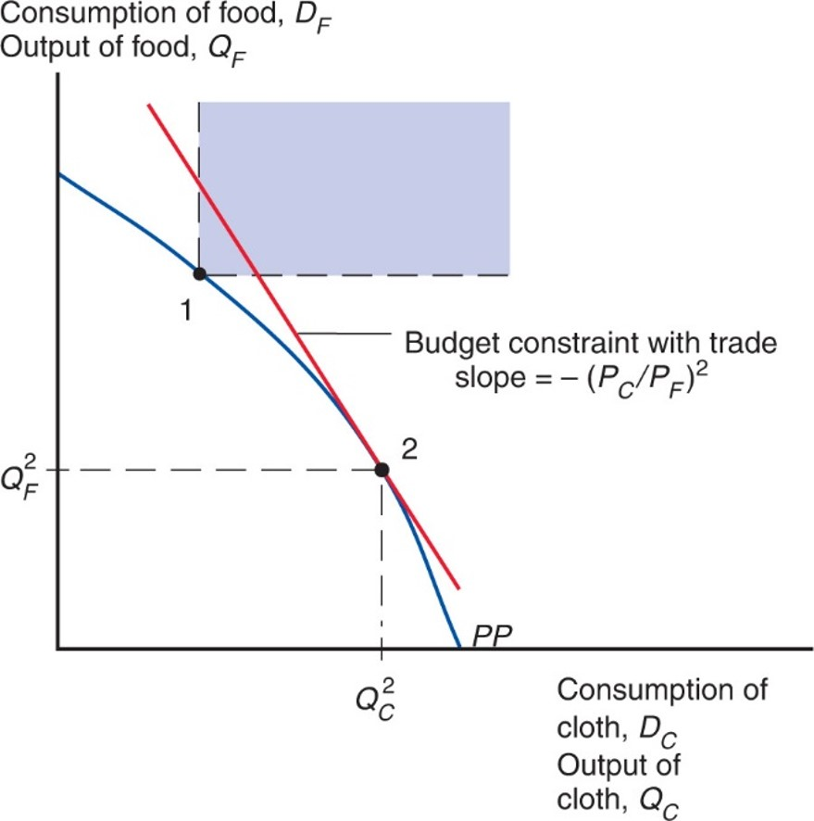
Figure 4.11 Budget Constraint for a Trading Economy and Gains from Trade
Point 2 represents the economy’s production. The economy can choose its consumption point along its budget constraint (a line that passes through point 2 and has a slope equal to minus the relative price of cloth). Before trade, the economy must consume what it produces, such as point 1 on the production possibility frontier (P P). The portion of the budget constraint in the colored region consists of feasible post-trade consumption choices, with consumption of both goods higher than at pretrade point 1.
Notes:
The plot for P P falls with increasing steepness from y-axis to x-axis, through points 1 and 2. Point 1 is higher on the plot, and forms the lower left vertex of the colored rectangular region. Point 2 is lower, where y = Q sub F super 1 and x = Q sub C super 1. The slope at point 2 indicates budget constraint with trade slope, = negative P sub C over P sub F, super 2.

Slide 7
Politics of Trade Protection (1 of 4)
International trade shifts the relative price of cloth to food, so factor prices change.
Trade benefits the factor that is specific to the export sector of each country, but hurts the factor that is specific to the import-competing sectors.
Trade has ambiguous effects on mobile factors.

Slide 8
Politics of Trade Protection (2 of 4)
Trade benefits a country by expanding choices.
Possible to redistribute income so that everyone gains from trade.
Those who gain from trade could compensate those who lose and still be better off themselves.
That everyone could gain from trade does not mean that they actually do—redistribution usually hard to implement.

Slide 9
Politics of Trade Protection (3 of 4)
Trade often produces losers as well as winners.
Optimal trade policy must weigh one group’s gain against another’s loss.
Some groups may need special treatment because they are already relatively poor (e.g., shoe and garment workers in the United States).
Most economists strongly favor free trade.

Slide 10
Politics of Trade Protection (4 of 4)
Typically, those who gain from trade are a much less concentrated, informed, and organized group than those who lose.
Example: Consumers and producers in the U.S. sugar industry, respectively
Governments usually provide a “safety net” of income support to cushion the losses to groups hurt by trade (or other changes).

Slide 11
Trade and Unemployment (1 of 3)
Trade shifts jobs from import-competing to export sector.
Process not instantaneous—some workers will be unemployed as they look for new jobs.
How much unemployment can be traced back to trade?
From 2001 to 2010, only about 2% of involuntary displacements stemmed from import competition or plants moved overseas.

Slide 12
Trade and Unemployment (2 of 3)
U.S. Trade Adjustment Assistance program provides extended unemployment coverage (for an additional year) and tuition reimbursement (for new job skill acquisitions) to workers who are displaced by a plant closure.
To qualify, the plant closure must be due to import competition or an overseas relocation to a country receiving preferential access to the United States.

Slide 13
Trade and Unemployment (3 of 3)
Figure 4.12 shows that there no evidence of a positive correlation between unemployment and imports (relative to U.S. G D P) for the United States.
After 2012, both imports and unemployment do drop significantly; However, the drop in imports was driven by falling oil prices. Non-oil imports as a share of U.S. G D P remained stable in those years.
Unemployment is primarily a macroeconomic problem that rises during recessions.
The best way to reduce unemployment is by adopting macroeconomic policies to help the economy recover, not by adopting trade protection.

Slide 14
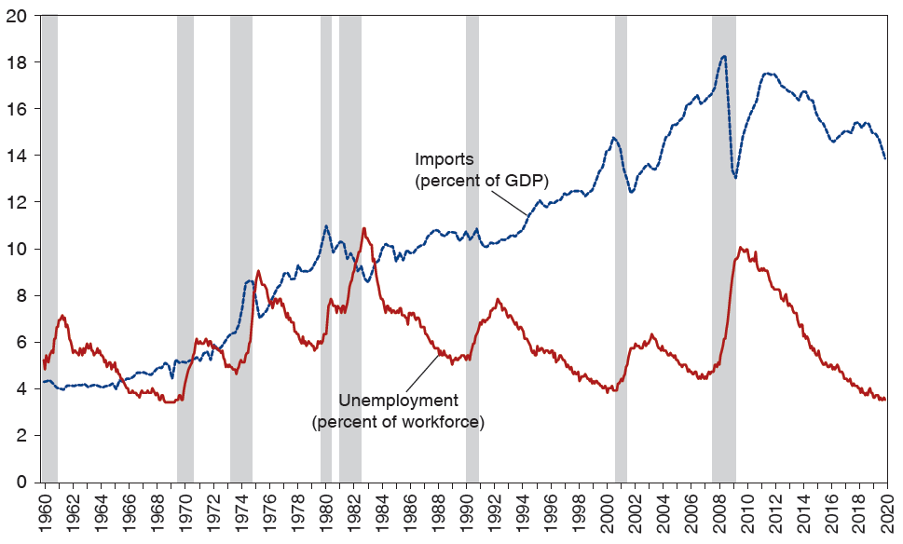
Figure 4.12 Unemployment and Import Penetration in the United States
The highlighted years are recession years, as determined by the National Bureau of Economic Research.
Source: U.S. Bureau of Economic Analysis for imports and U.S. Bureau of Labor Studies for unemployment.
Notes:
The graph depicts percentages for both imports as a percent of G D P and unemployment as a percent of the workforce, versus years 19 60 to 20 20. Recessions are highlighted, with corresponding spikes in unemployment and dips in imports. The plot for imports generally rises from (19 60, 4.3) through (19 90, 9.8) to (20 12, 17), and then falls to (20 20, 14). A significant dip occurs at (2009, 13). The plot for unemployment rises and falls inconsistently, through points (19 60, 5), (19 82, 11), (19 90, 5), (2009, 9), and (20 20, 3.5). The shaded areas for U S recessions, by years, are as follows. 19 60 to 19 61, 19 70, 19 73 to 19 75, 19 80, 19 81 to 19 83, 19 90 to 19 91, 2001, 2008 to 2009. All values are estimated.

Slide 15
Manufacturing Employment and Chinese Import Competition (1 of 2)
Is import competition from developing countries—especially from China—at fault for declines in manufacturing employment in the United States?
Would closing off the United States from trade with China increase the share of employment in U.S. manufacturing?
Some workers in sectors that compete with Chinese imports may lose their jobs and take time to find new jobs.
Meanwhile, jobs are opening up in the export sectors of the economy.
What is the net effect of increase import competition on manufacturing employment?

Slide 16
Manufacturing Employment and Chinese Import Competition (2 of 2)
Figure 4.13 shows that this manufacturing employment share has been steadily decreasing over the last half-century.
U.S. manufacturing was still producing the same quantity of goods, but was using fewer and fewer workers (due to increase productivity).
Estimate share of manufacturing employment using data from before China became a major source of U.S. imports.
Accurate fit to manufacturing employment now.
China appears to have little, if any, effect.

Slide 17
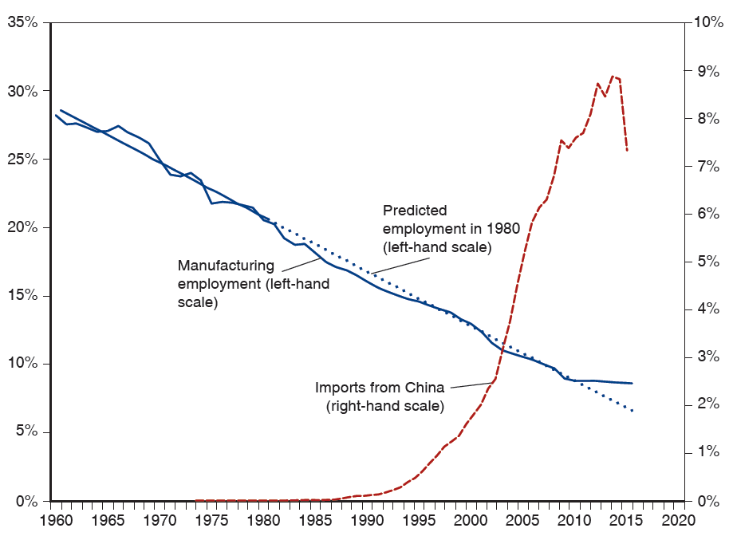
Figure 4.13 U.S. Manufacturing Employment and Imports from China
Manufacturing employment is measured as a percent of total U.S. non-farm employment. Imports from China are measured as a percent of the U.S. manufacturing production.
Notes:
The graph depicts percentages of U S manufacturing employment, versus years 19 60 to 20 20. Manufacturing employment fell from 28% in 19 60 to 10% in 20 20, and closely followed the predicted employment. Imports from China rose gradually from (19 72, 0.1%) to (19 85, 0.5%) and then rose steeply from (19 90, 0.25%) to (20 17, 7.5%). All values are estimated.

Slide 18
The Trump Trade War
Substantial political pressure to protect import-competing sectors, even if leads to aggregate losses.
Trade protection usually limited to a few hard-hit sectors.
The Trump administration enacted a vast set of tariffs on solar panels, washing machines, steel, aluminium, and an expanding list of manufactured good produced in China.
Many of the protected sectors contained a high proportion of intermediate goods imported by U.S. producers, harming jobs in these downstream sectors.
Retaliation by trading partners had a negative impact on employment by U.S. exporters.

Slide 19
International Labor Mobility (1 of 6)
Movements in factors of production include
Labor migration
The transfer of financial assets through international borrowing and lending
Transactions of multinational corporations involving direct ownership of foreign firms
Like movements of goods and services (trade), movements of factors of production are politically sensitive and are often restricted.

Slide 20
International Labor Mobility (2 of 6)
Why does labor migrate and what effects does labor migration cause?
Workers migrate to wherever wages are highest.
Consider movement of labor across countries instead of across sectors.
Suppose two countries produce one non-traded good (food) using two factors of production:
Land cannot move across countries but labor can.

Slide 21
International Labor Mobility (3 of 6)
Figure 4.13 finds the equilibrium wage and labor allocation with migration across countries.
Similar to how Figure 4.4 determined the equilibrium allocation of labor between sectors.
Start with
workers in Home earning a lower real wage
(point C) than the
workers in Foreign (point B).
Lower wage due to less land per worker (lower productivity).
Workers in the home country want to migrate to the foreign country where they can earn more.

Slide 22
International Labor Mobility (4 of 6)
If no obstacles to labor migration, workers move from Home to Foreign until the purchasing power of wages is equal across countries (point A),
with
workers in Home and
workers in Foreign.
Emigration from Home decreases the supply of labor and raises real wage of the workers who remain there.
Workers who start in the Home country earn more due to emigration regardless if they are among those who leave.
Immigration into Foreign increases the supply of labor and decreases the real wage there.
Wages do not actually equalize, due to barriers to migration such as policies restricting immigration and natural reluctance to move.

Slide 23
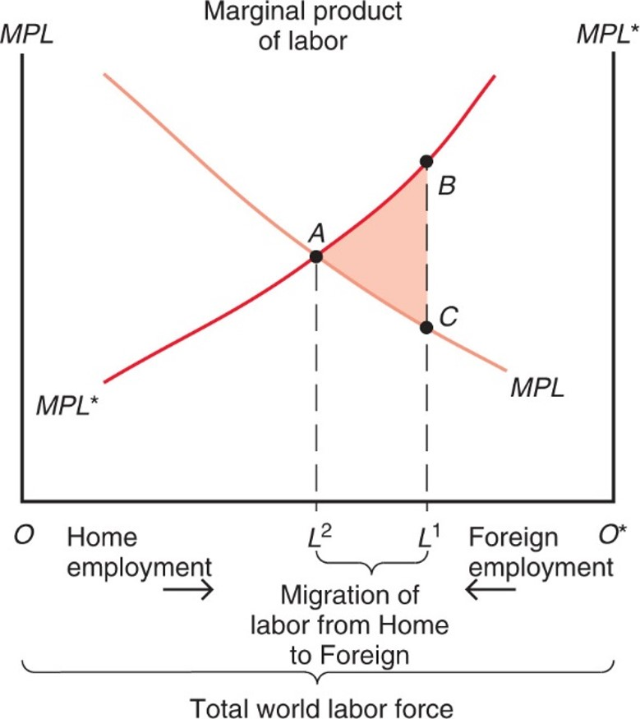
Figure 4.14 Causes and Effects of International Labor Mobility
Initially,
workers are employed in Home, while
workers are employed in Foreign. Labor migrates from Home to
Foreign until
workers are employed in Home,
in Foreign, and wages are equalized.
Notes:
versus total world labor force, which is split between home employment, O, on the left and foreign employment, O asterisk, on the right. The graph plots two curves, M P L for home labor, and M P L asterisk for foreign labor. The marginal product of home labor falls with decreasing steepness from left to right. The marginal product of foreign labor rises with increasing steepness from left to right. The plots intersect at point Ay, where x = L super 2. To the right of point Ay, rising on the M P L asterisk, is point B, where x = L super 1. Point C, falling on the M P L curve, is directly below point B, where x = L super 1. The triangular area between points Ay, B, and C is shaded and represents the migration of labor from home to foreign, the difference between L super 2 and L super 1.

Slide 24
International Labor Mobility (5 of 6)
Workers initially in Home benefit while workers in Foreign are hurt by inflows of other workers.
Landowners in Foreign gain from the inflow of workers decreasing real wages and increasing output.
Landowners in Home are hurt by the outflow of workers increasing real wages and decreasing output.

Slide 25
International Labor Mobility (6 of 6)
Due to higher wages in Western Europe relative to its new E U partners in Eastern Europe, there have been substantial east-to-west migration flows.
Has this process been associated with wage convergence as predicted by our model of labor mobility? Yes, it has.
Figure 4.15 plots the relative wage of manufacturing workers from the new 2004 member countries relative to Western Europe.
Large compensation differentials still persist, but the trend is toward convergence.

Slide 26
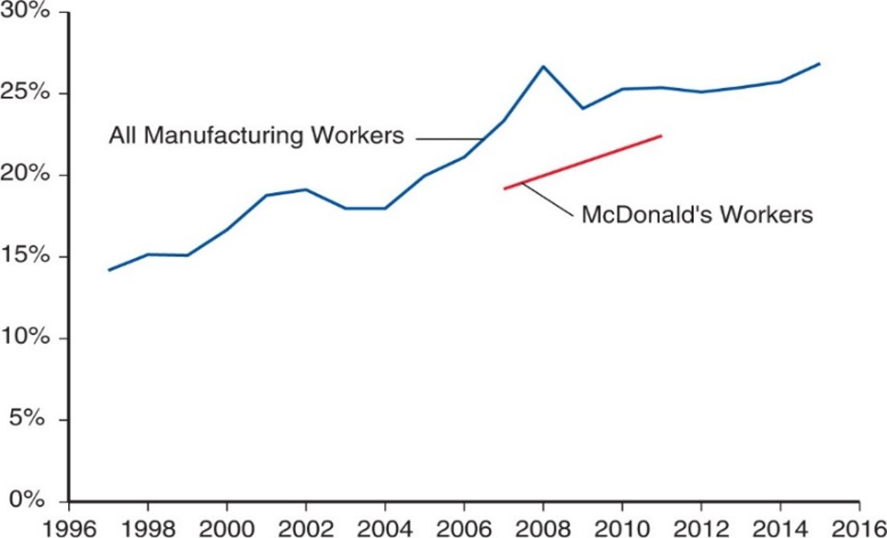
Figure 4.15 Eastern–Western Europe Relative Compensation 1997–2015
Western Europe includes: Austria, Belgium, Denmark, Finland, France, Germany, Greece, Ireland, Italy, Netherlands, Norway, Portugal, Spain, Sweden, Switzerland, and the United Kingdom. Eastern Europe includes: the Czech Republic, Estonia, Hungary, Poland, Slovakia.
Source: The Conference Board International Labor Comparisons, 2016; and Orley Ashenfelter and Stepan Jurajda, "Comparing Real Wage Rates using McWages", mimeo, 2020.
Notes:
The plot for all manufacturing workers rises from (1997, 14) through (2008, 27) to (2015, 27). Below it, the plot for McDonald’s is a straight line that rises from (2007, 18) to (2011, 22). All values estimated.

Slide 27
Immigration and the U.S. Economy (1 of 2)
In the early 20th century, share of immigrants in the United States increased dramatically.
Vast immigration from Eastern and Southern Europe.
Tight restrictions on immigration imposed in the 1920s.
Immigrants were a minor force in the United States by the 1960s.
New wave of immigration began around 1970.
Mostly from Latin America and Asia.
As of 2014, 16.7% of the U.S. labor force is foreign-born.

Slide 28
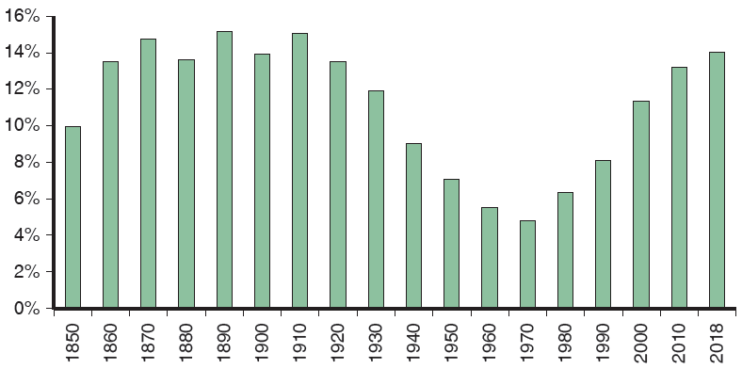
Figure 4.16 Foreign-Born Population as a Percentage of the U.S. Population
Restrictions on immigration in the 1920s led to a sharp decline in the foreign-born population in the mid-20th century, but immigration has risen sharply again in recent decades.
Source: U.S. Census Bureau.
Notes:
The bar graph depicts percentage of the foreign born population in the U S versus decades, 18 50 to 20 10, and 2018. From 18 50 to 19 10, the foreign born population as a percentage of the U S population generally grew from 10% to 14.5%. From 19 20 to 19 70 the percentage declined each decade from 13.5% to 5%. In 19 80, it started to rise again each decade, from 7% to 13% in 20 18. All values are estimated.

Slide 29
Immigration and the U.S. Economy (2 of 2)
The largest increase in recent immigration occurred among workers with the lowest education levels, making less educated workers more abundant.
Possibly reduced wages for native-born workers with low education levels while raising wages for the more educated
Widening wage gap between less educated workers and highly educated workers.

Slide 30
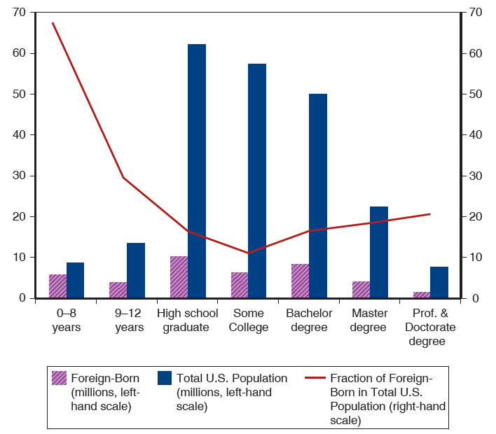
Figure 4.17 Foreign-Born and Total U.S. Population Over 25 Years Old by Educational Attainment
Relative to native-born workers, foreign-born workers are concentrated in both the highest and lowest educational groups.
Source: U.S. Census Bureau.
Notes:
The bar graph depicts foreign born and total U S population, in millions, by 7 levels of education, and is overlaid with a curve of the percentage of foreign born in the U S population. The following list provides number of workers, in millions, for foreign born then total U S population, by education level. 0 to 8 years, 6 million, 12 million. 9 to 12 years, 4 million, 16 million. High school graduate, 8 million, 64 million. 12 to 15 years, 5 million, 54 million. Bachelor degree, 8 million, 52 million. Master degree, 4 million, 22 million. Professional and doctorate degree, 1 million, 8 million. The plot for fraction of foreign born in the total U S population falls steeply from (0 to 8 years, 69%) to (9 to 12 years, 29%), then continues to fall through (high school graduate, 13%), and (Some college, 12%). The plot then rises through (bachelor degree, 18%), (master degree, 19%), and (professional and doctorate degrees, 22%). All values are estimated.

Slide 31
Summary (1 of 4)
International trade often has strong effects on the distribution of income within countries—produces losers as well as winners.
Income distribution effects arise for two reasons:
Factors of production cannot move costlessly and quickly from one industry to another.
Changes in an economy’s output mix have differential effects on the demand for different factors of production.

Slide 32
Summary (2 of 4)
International trade affects the distribution of income in the specific factors model.
Factors specific to export sectors in each country gain from trade, while factors specific to import-competing sectors lose.
Mobile factors that can work in either sector may either gain or lose.

Slide 33
Summary (3 of 4)
Trade nonetheless produces overall gains in the sense that those who gain could in principle compensate those who lose while still remaining better off than before.
Most economists would prefer to address the problem of income distribution directly, rather than by restricting trade.
Those hurt by trade are often better organized than those who gain, causing trade restrictions to be adopted.

Slide 34
Summary (4 of 4)
Labor migrates to countries with higher labor productivity and higher real wages, where labor is scarce.
Real wages fall due to immigration and rise due to emigration.
World output increases.
Real wages across countries are far from equal due to differences in technology and due to immigration barriers.

Slide 35
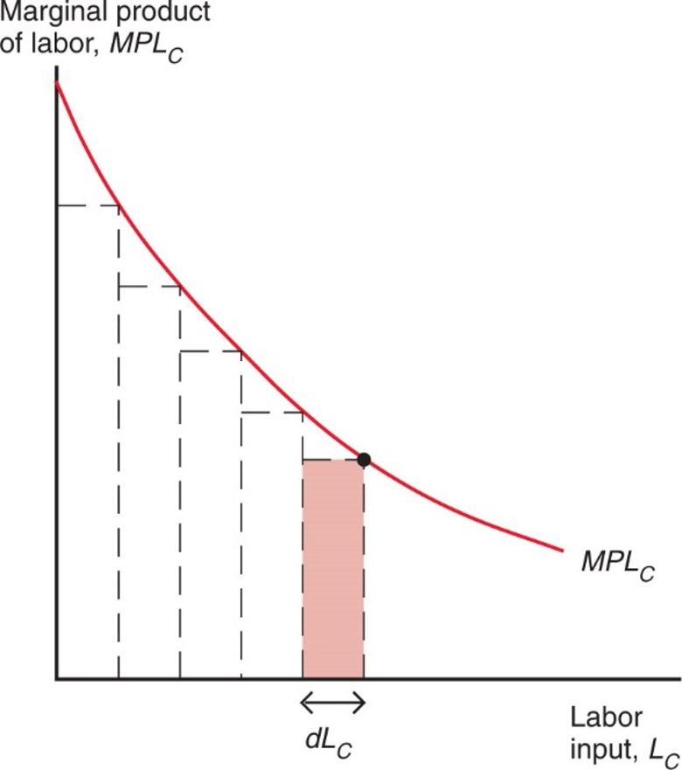
Figure 4A.1 Showing That Output Is Equal to the Area under the Marginal Product Curve
By approximating the marginal product curve with a series of thin rectangles, one can show that the total output of cloth is equal to the area under the curve.
Notes:
Under the curve are 5 rectangles formed by dotted lines, beginning at the y-axis, each the same width, d L sub C, along the x-axis. The upper right vertex of each rectangle is a point along the M P L sub C curve.

Slide 36
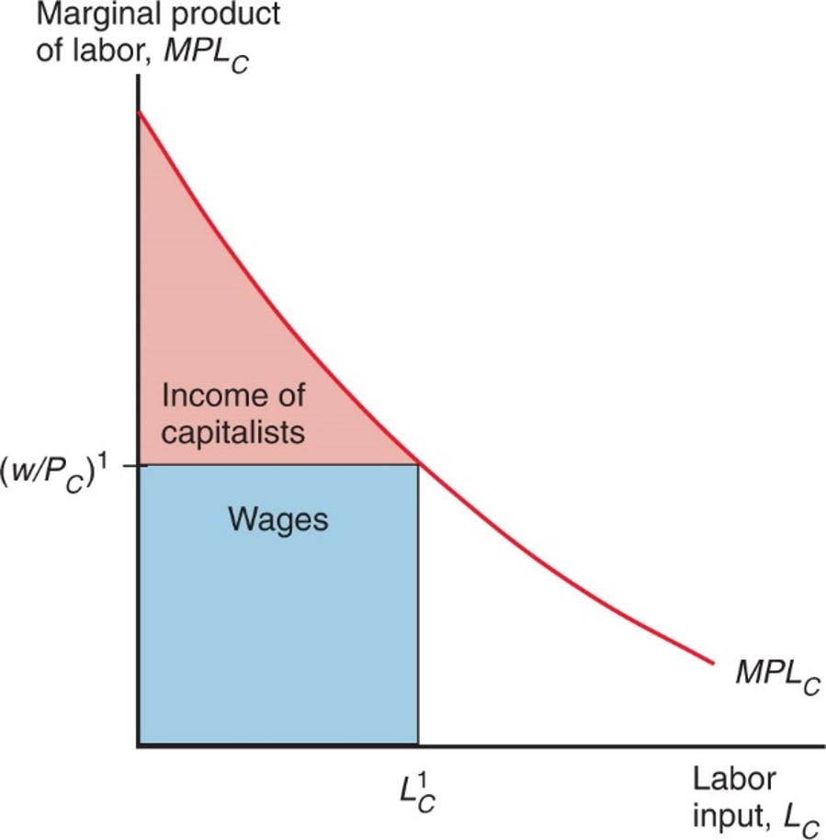
Figure 4A.2 The Distribution of Income within the Cloth Sector
Labor income is equal to the real wage times employment. The rest of output accrues as income to the owners of capital.
Notes:
The curve for M P L sub C falls with decreasing steepness from the y-axis. Roughly midway along the curve, a point forms the upper right vertex of a rectangle under the curve, where y = w over P sub C, super 1. The shaded rectangle, below this line, represents wages. A roughly triangular, shaded area above this line, between the y-axis and M P L sub C curve, represents the income of capitalists.

Slide 37
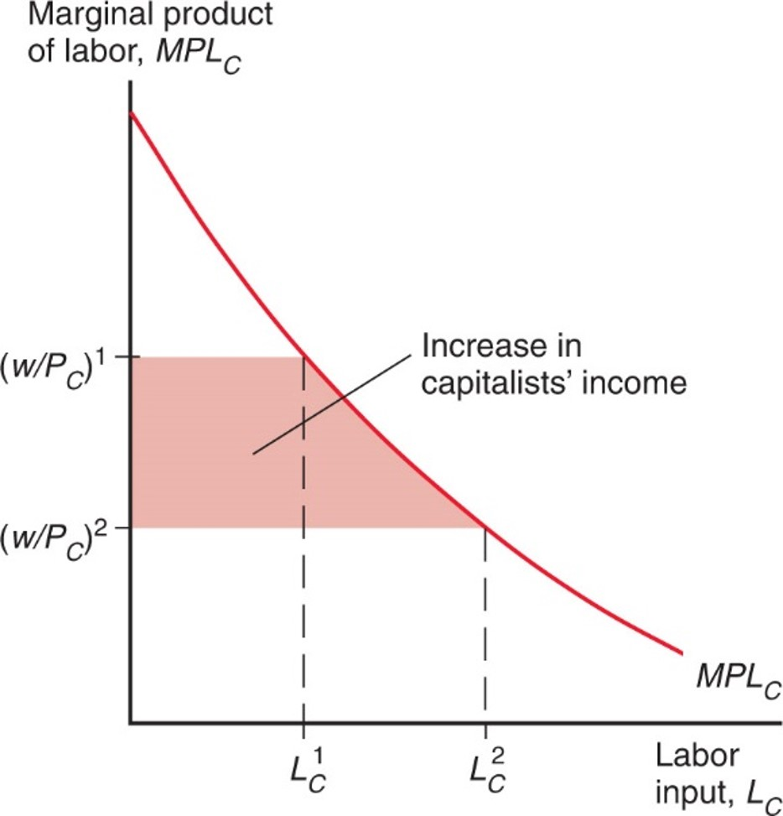
Figure 4A.3 A Rise in P Sub C Benefits the Owners of Capital
The real wage in terms of cloth falls, leading to a rise in the income of capital owners.
Notes:
The curve for M L P sub C falls with decreasing steepness from the y-axis. Dotted lines intersect the curve at x = L sub C super 1, and to the right at L sub C super 2. At x = L sub C super 1, y = w over P sub C, super 1; at x = L sub C super 2, y = w over P sub C, super 2. The area between the 2 intersections and the y-axis is shaded, and represents the increase in capitalists’ income.

Slide 38
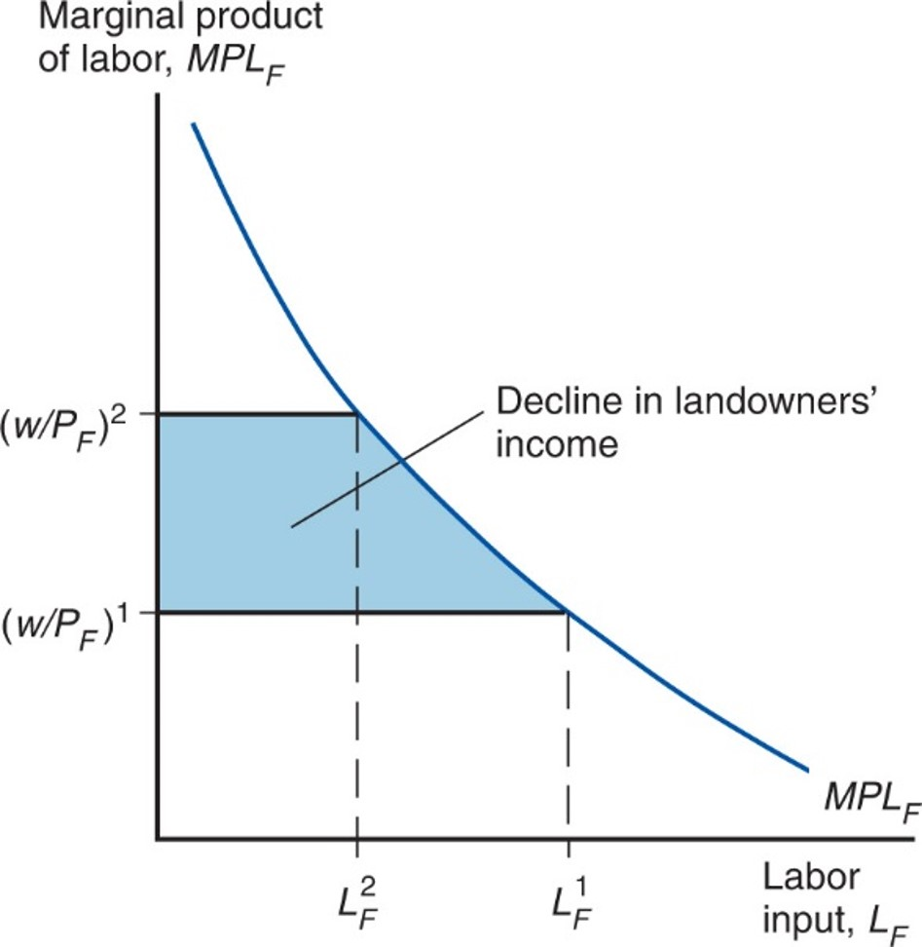
Figure 4A.4 A Rise in P Sub C Hurts Landowners
The real wage in terms of food rises, reducing the income of land.
Notes:
A plot for M P L sub F falls with decreasing steepness. Dotted lines intersect the curve at x = L sub F super 2, and to the right at L sub F super 1. At x = L sub F super 2, y = w over P sub F, super 2; at x = L sub F super 1, y = w over P sub F, super 1. The area between the 2 intersections and the y-axis is shaded, and represents the decline in landowners’ income.

